Slide 1
ML based Stress Management Application.
Name | Registeration Number
Mohanlal Bishnoi | RA1611008010109
Rajat Rastogi | RA1611008010105
Arun Kumar | RA1611008010087

Slide 2
Abstract:
A prediction is an android application system that strain is now identified as one of the fundamental causes of physical and mental illness. It is called a response to surrounding environmental threats and the pleasant way to manage it's far to understand its triggers. Although people continuously react to their surrounding environments, they sometimes aren't conscious that certain factors in their environment are considered to be stressors. Based in this fact, researchers have these days proposed context-aware pressure management structures. Most of the proposed systems use context data to provide real time pressure tracking and visualization, at the side of intervention techniques. So, the user strain can be predicate in our application to user deliver a capturing picture on the display and to detected a emotion process may be checking subsequently the user relief a stress the usage of an software.

Slide 3
Introduction
Stress can be positive while it helps motivate us and encourages us to take action. However, experiencing an excessive amount of pressure for a long period of time can be overwhelming and can have negative outcomes on our bodily and mental wellbeing. This sort of problematic strain is referred to as distress. Stress also can contribute in a roundabout way to illnesses which can be associated with unhealthy conduct that generally tend to boom beneath excessive strain, for instance smoking and lack of sleep

Slide 4
Literature Review
Title: Detection of Stress Using Image Processing and Machine Learning Techniques
Year: July 2017
Description:. Monitoring the emotional status of a person who is working in front of a computer for longer duration is crucial for the safety of a person. In this work a real-time non-intrusive videos are captured, which detects the emotional status of a person by analysing the facial expression
Authors: Nisha Raichur, Nidhi Lonakadi, Priyanka Mural

Slide 5
Title: Facial Emotion Recognition System Using ML
Year: March 2017
Description:. The emotions, set in simple words are what people feel. Emotional aspects have huge impact on Social intelligence like communication understanding, decision making and helps in understanding behavioral aspect of human. Human faces provide various information about emotions.
Authors: Renuka Deshmukh, Vandana Jagtap

Slide 6
Title: A System to detect mental stress using Machine Learning
Year:July 2018
Description:. According to American Psychological Association (APA) 2012 study, “Stress is costing organizations a Fortune” and some cases as much as $300 billion a year. The challenges, importantly, for the individuals and the organizations are lack of proactive detection of the stress and inept preventive actions to manage mental health to circumvent adverse affects of the stress.
Authors: Nisha Raghu, Suma Khursheed

Slide 7
EXISTING SYSTEM & PROPOSED SYSTEM
EXISTING SYSTEM: -
In existing framework given solution the users have to first get themselves the designed with different stress recognition and management methods, based on their final goal, whether that is stress detection, monitoring and visualizing, or management.
Drawbacks:
Existing systems for mood prediction are that mood is treated as a binary state
The lowest possible mood score is treated as equivalent to a slightly lower than average score.

Slide 8
PROPOSED SYSTEM: -
A proposed context-aware stress management system. Most of the proposed systems use context data to provide real time stress monitoring and visualization
Advantages:
Its personalization can provide advantages in predicting mood and wellbeing, a problem where interindividual variability is high.
The user face expression to get an emotion detection.

Slide 9

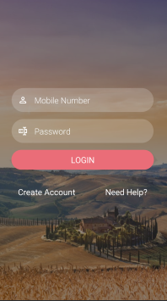
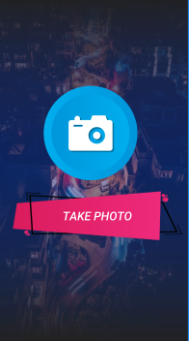
UI ScreenShot and Code Implementation

Slide 10
Code Review- #TakePhoto Class
public class Takephoto extends AppCompatActivity {
Button button;
@Override
protected void onCreate(Bundle savedInstanceState) {
super.onCreate(savedInstanceState);
setContentView(R.layout.activity_takephoto);
button = findViewById(R.id.take_photo);
button.setOnClickListener(new View.OnClickListener() {
@Override
public void onClick(View v) {
startActivity(new Intent(getApplicationContext(),ImageActivity.class));
}
});
}
}

Slide 11
#DashBoard Activity
public class Dashboard extends AppCompatActivity {
ImageView ione;
@Override
protected void onCreate(Bundle savedInstanceState) {
super.onCreate(savedInstanceState);
setContentView(R.layout.activity_dashboard);
ione = findViewById(R.id.ione);
ione.setOnClickListener(new View.OnClickListener() {
@Override
public void onClick(View v) {
Intent i = new Intent(getApplicationContext(),Takephoto.class);
startActivity(i);
}
});
}
}

Slide 12
MODULES
Login and Registration
Database Creation
Capturing Screen
Emotion Detection
Stress Relief

Slide 13
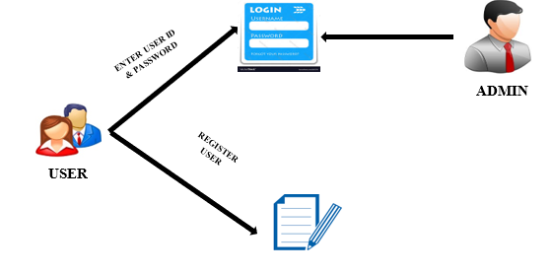
LOGIN AND REGISTRATION:
In this module we design to develop sign in and signup screen. We have two types of user namely customer and farmer. Android used xml to develop classical screens in our application. The sign in page for customer contains id and password, after confirming, if it matches Password to allow in the app otherwise alert an error Dialog and show a message to the user. The sign in for Manager contains id and Password, after confirming, if it matches Password to allow in the app otherwise alert an error Dialog and show a message to the user.

Slide 14
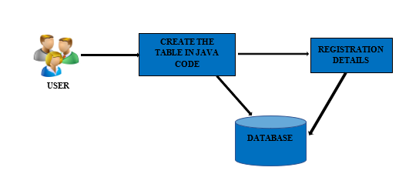
DATABASE CREATION
In the Database Creation Module, admin only has the rights to register an new user for both parent and Drivers. We want to store all details at cloud.so with the help of PHP and JSON we store all the data to the MYSQL database at cloud.

Slide 15
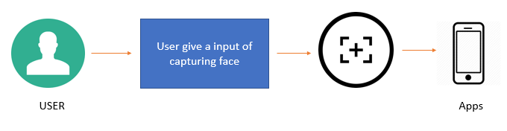
CAPTURING SCREEN:
In this module we have to develop a capturing a user face on the screen and capture the picture to store in Database storage. So, capturing screen module the user face can access using an application.

Slide 16
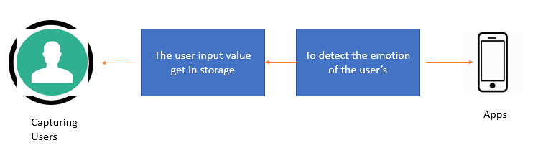
EMOTION DETECTION:
In this module we have to create an emotion detection the user face input gets on the screen to a solution for facial expression recognition that uses a combination specific image pre-processing step. It described the innovative solution that provides efficient face expression.

Slide 17
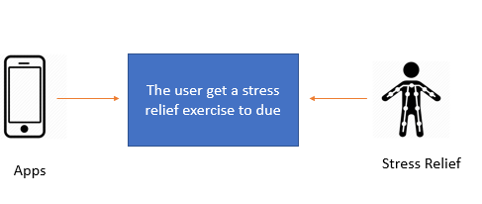
STRESS RELIEF:
In this module we have implement the stress relief to analysis the user information of through this apps. The stress relief process is analysis the result of the user face expression and the data can be stored. The user helps to breathing exercise are implement of the stress relief using an application.

Slide 18
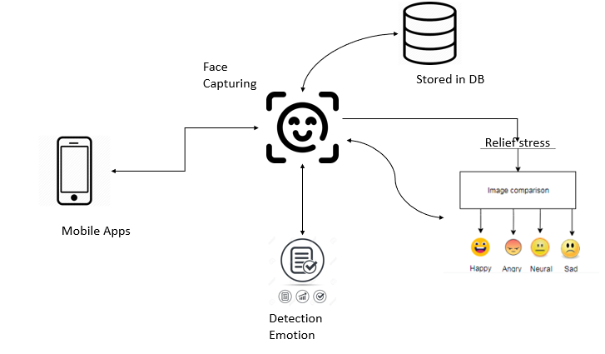
SYSTEM ARCHITECTURE:

Slide 19
SYSTEM REQUIREMENTS
HARDWARE
PROCESSOR : Intel Core i3.
RAM : 8 GB RAM
MONITOR : 15” COLOR
HARD DISK : 100 GB
SOFTWARE
Front End : ANDROID XML, JAVA
Back End : MYSQL, PHP
Operating System : WINDOWS 10
IDE : ANDROID STUDIO

Slide 20
Thank you.

